Slide 1
LR(0) Parser
Understanding the Basics of LR(0) Parsing
Presented by: Husnain Momin, Faizan Imran, Ali Ijaz, Hassan Nawaz, Bisma Arooj, Miraal Junaid, Zineera Rehman, Esha Fatima

Slide 2
What is an LR(0) Parser?
LR(0) stands for:
L: Left-to-right scanning
R: Rightmost derivation (in reverse)
0: Zero lookahead
Bottom-up parser
Attempts to reduce input to the start symbol
Simple, foundational parser type

Slide 3
Augmenting the Grammar
Add a new production: S&amp;apos; → S
Ensures unique starting point for parsing
Example:
Original: S → aA
Augmented: S&amp;apos; → S

Slide 4
LR(0) Items
A production with a dot (•) indicating parser progress
Example: A → aB
Items:
• A → •aB
• A → a•B
• A → aB•

Slide 5
Closure Operation
If dot is before a non-terminal B, include all productions of B starting with a dot
Example:
Item: A → •B
If B → bC, add B → •bC to closure

Slide 6
GOTO Operation
Move the dot over a grammar symbol (terminal or non-terminal)
Then compute closure of the new item set
Example:
From A → •aB, GOTO on &amp;apos;a&amp;apos; → A → a•B

Slide 7
Canonical Collection of States
Start from closure of S&amp;apos; → •S
Use GOTO repeatedly
Each set = DFA state
State diagram example will be shown below.

Slide 8
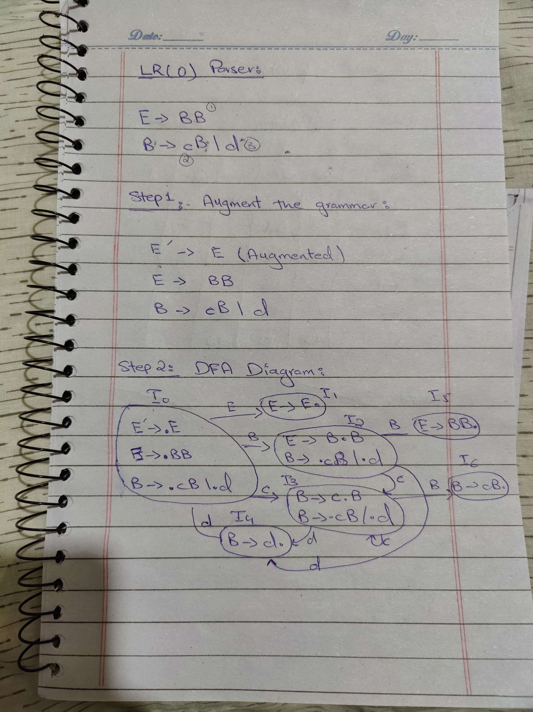
Example Question

Slide 9
Example Question

Slide 10
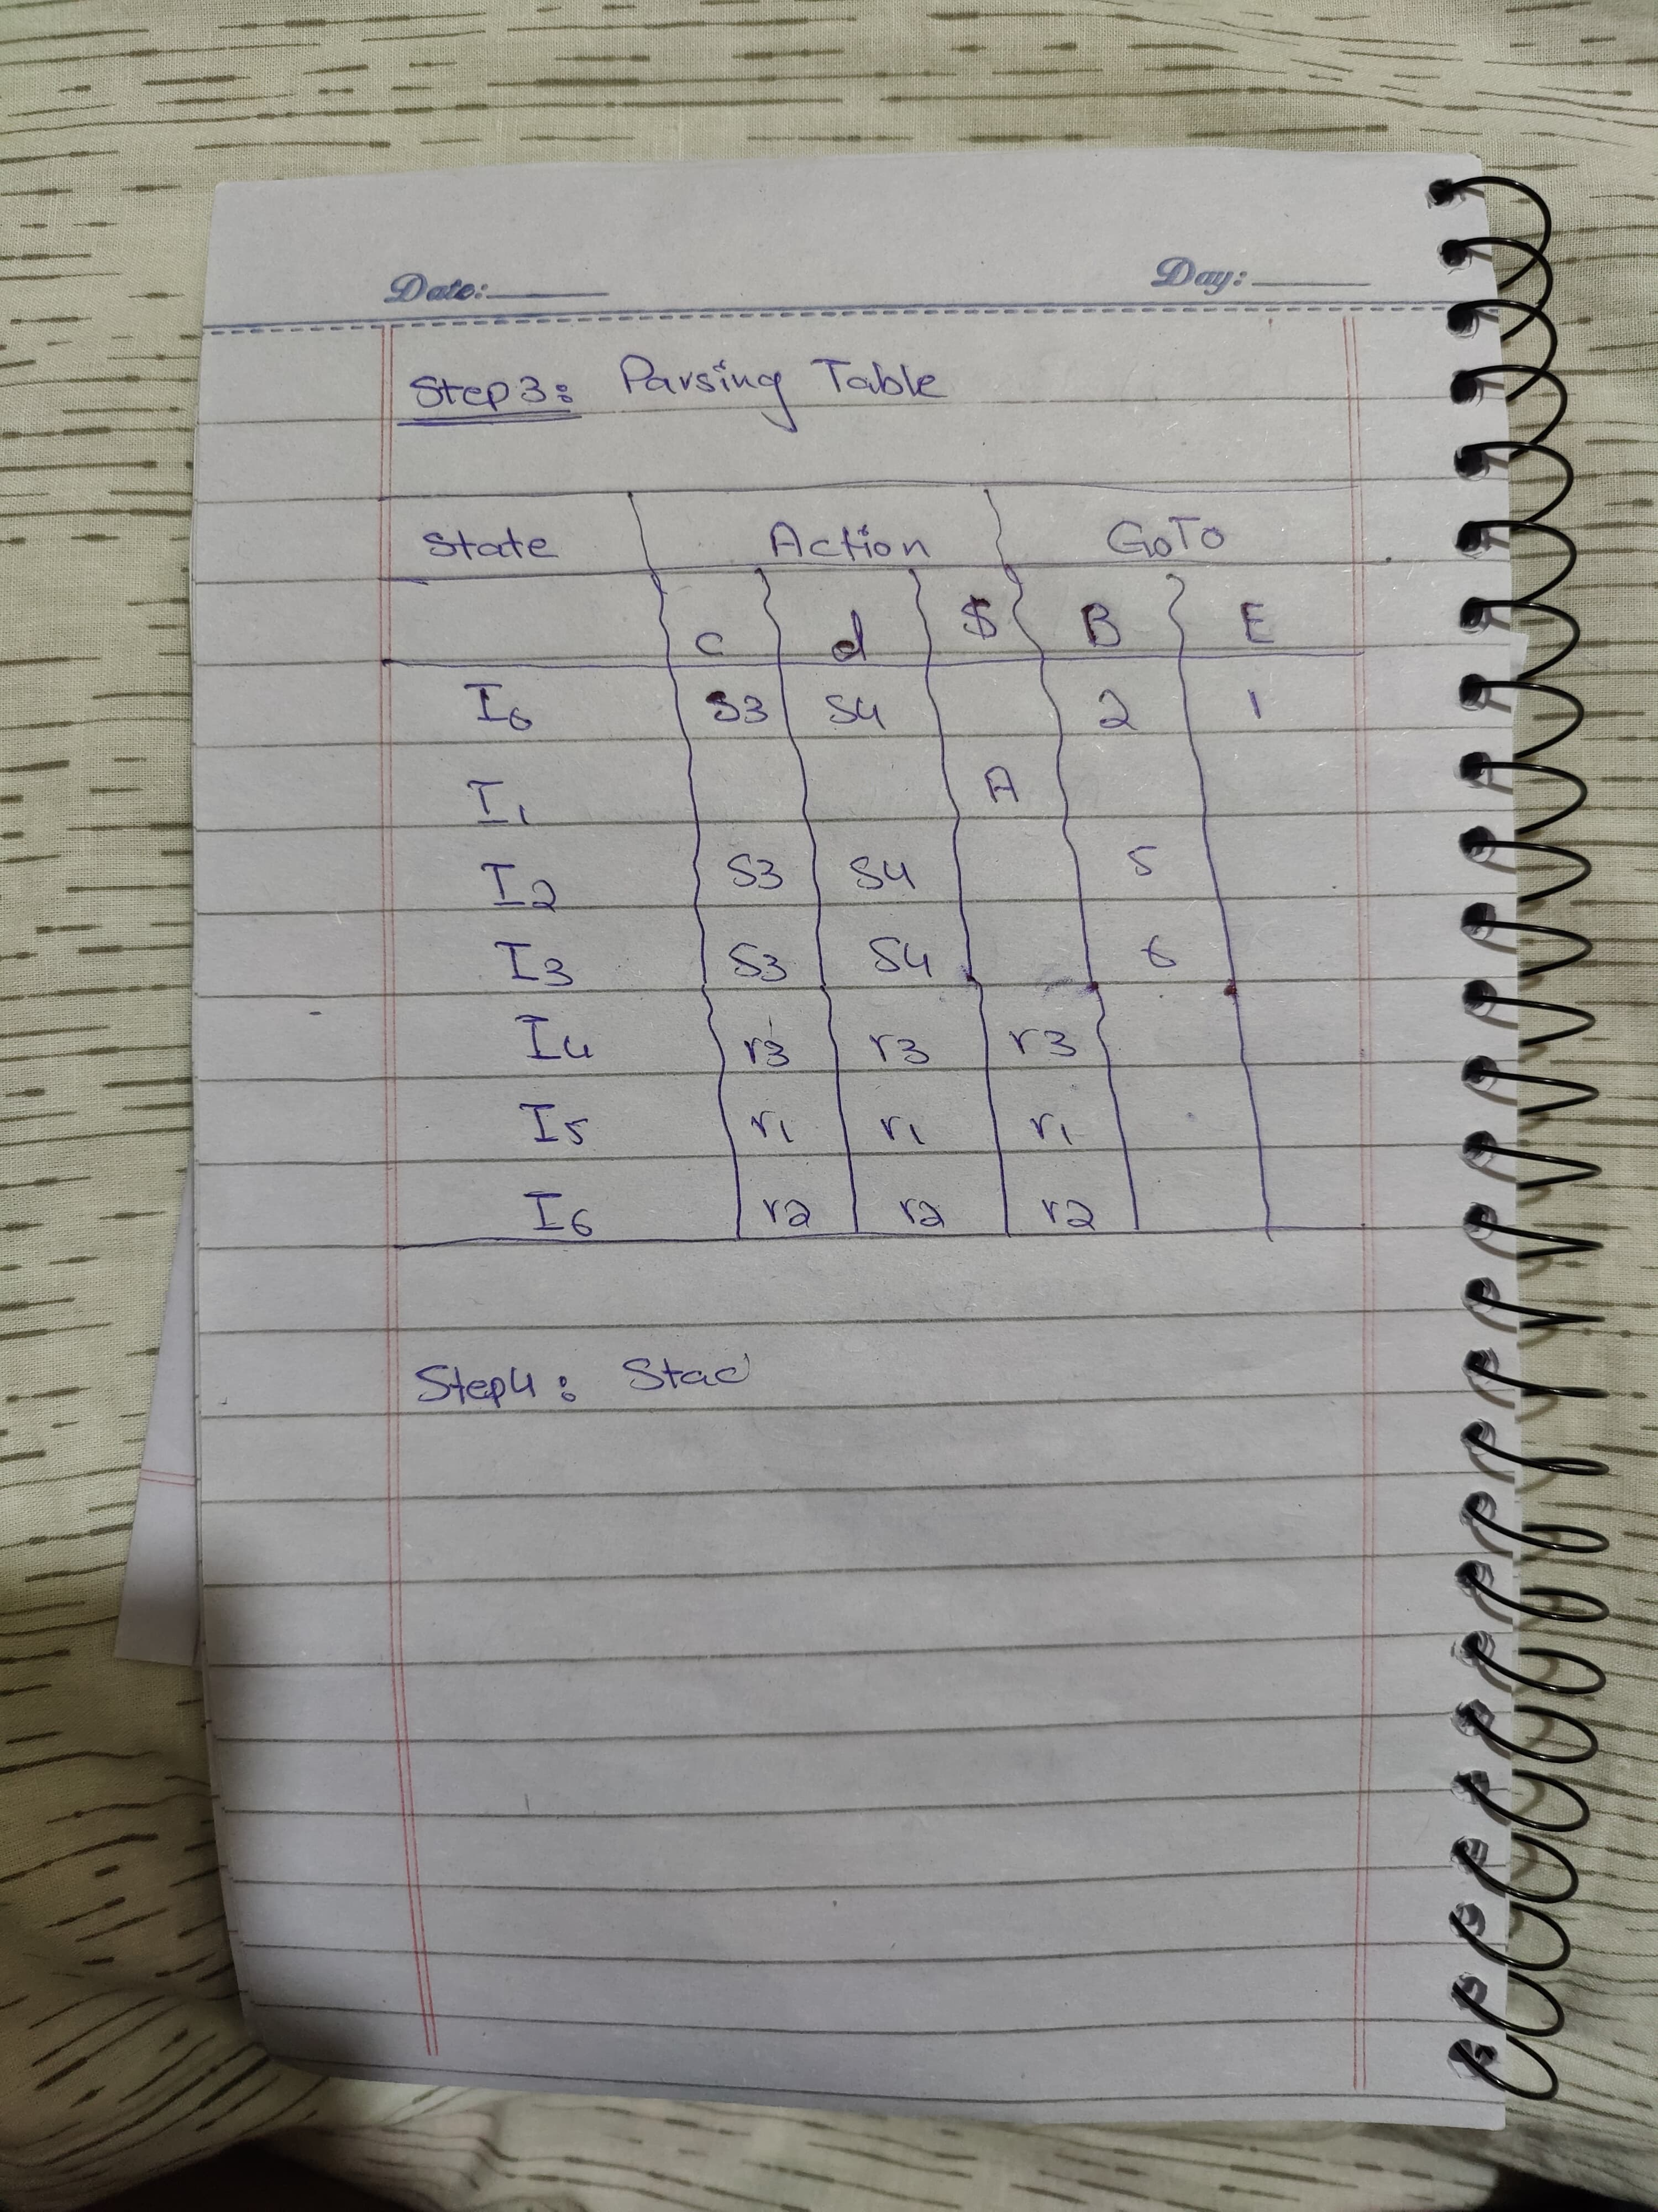
Example Question

Slide 11
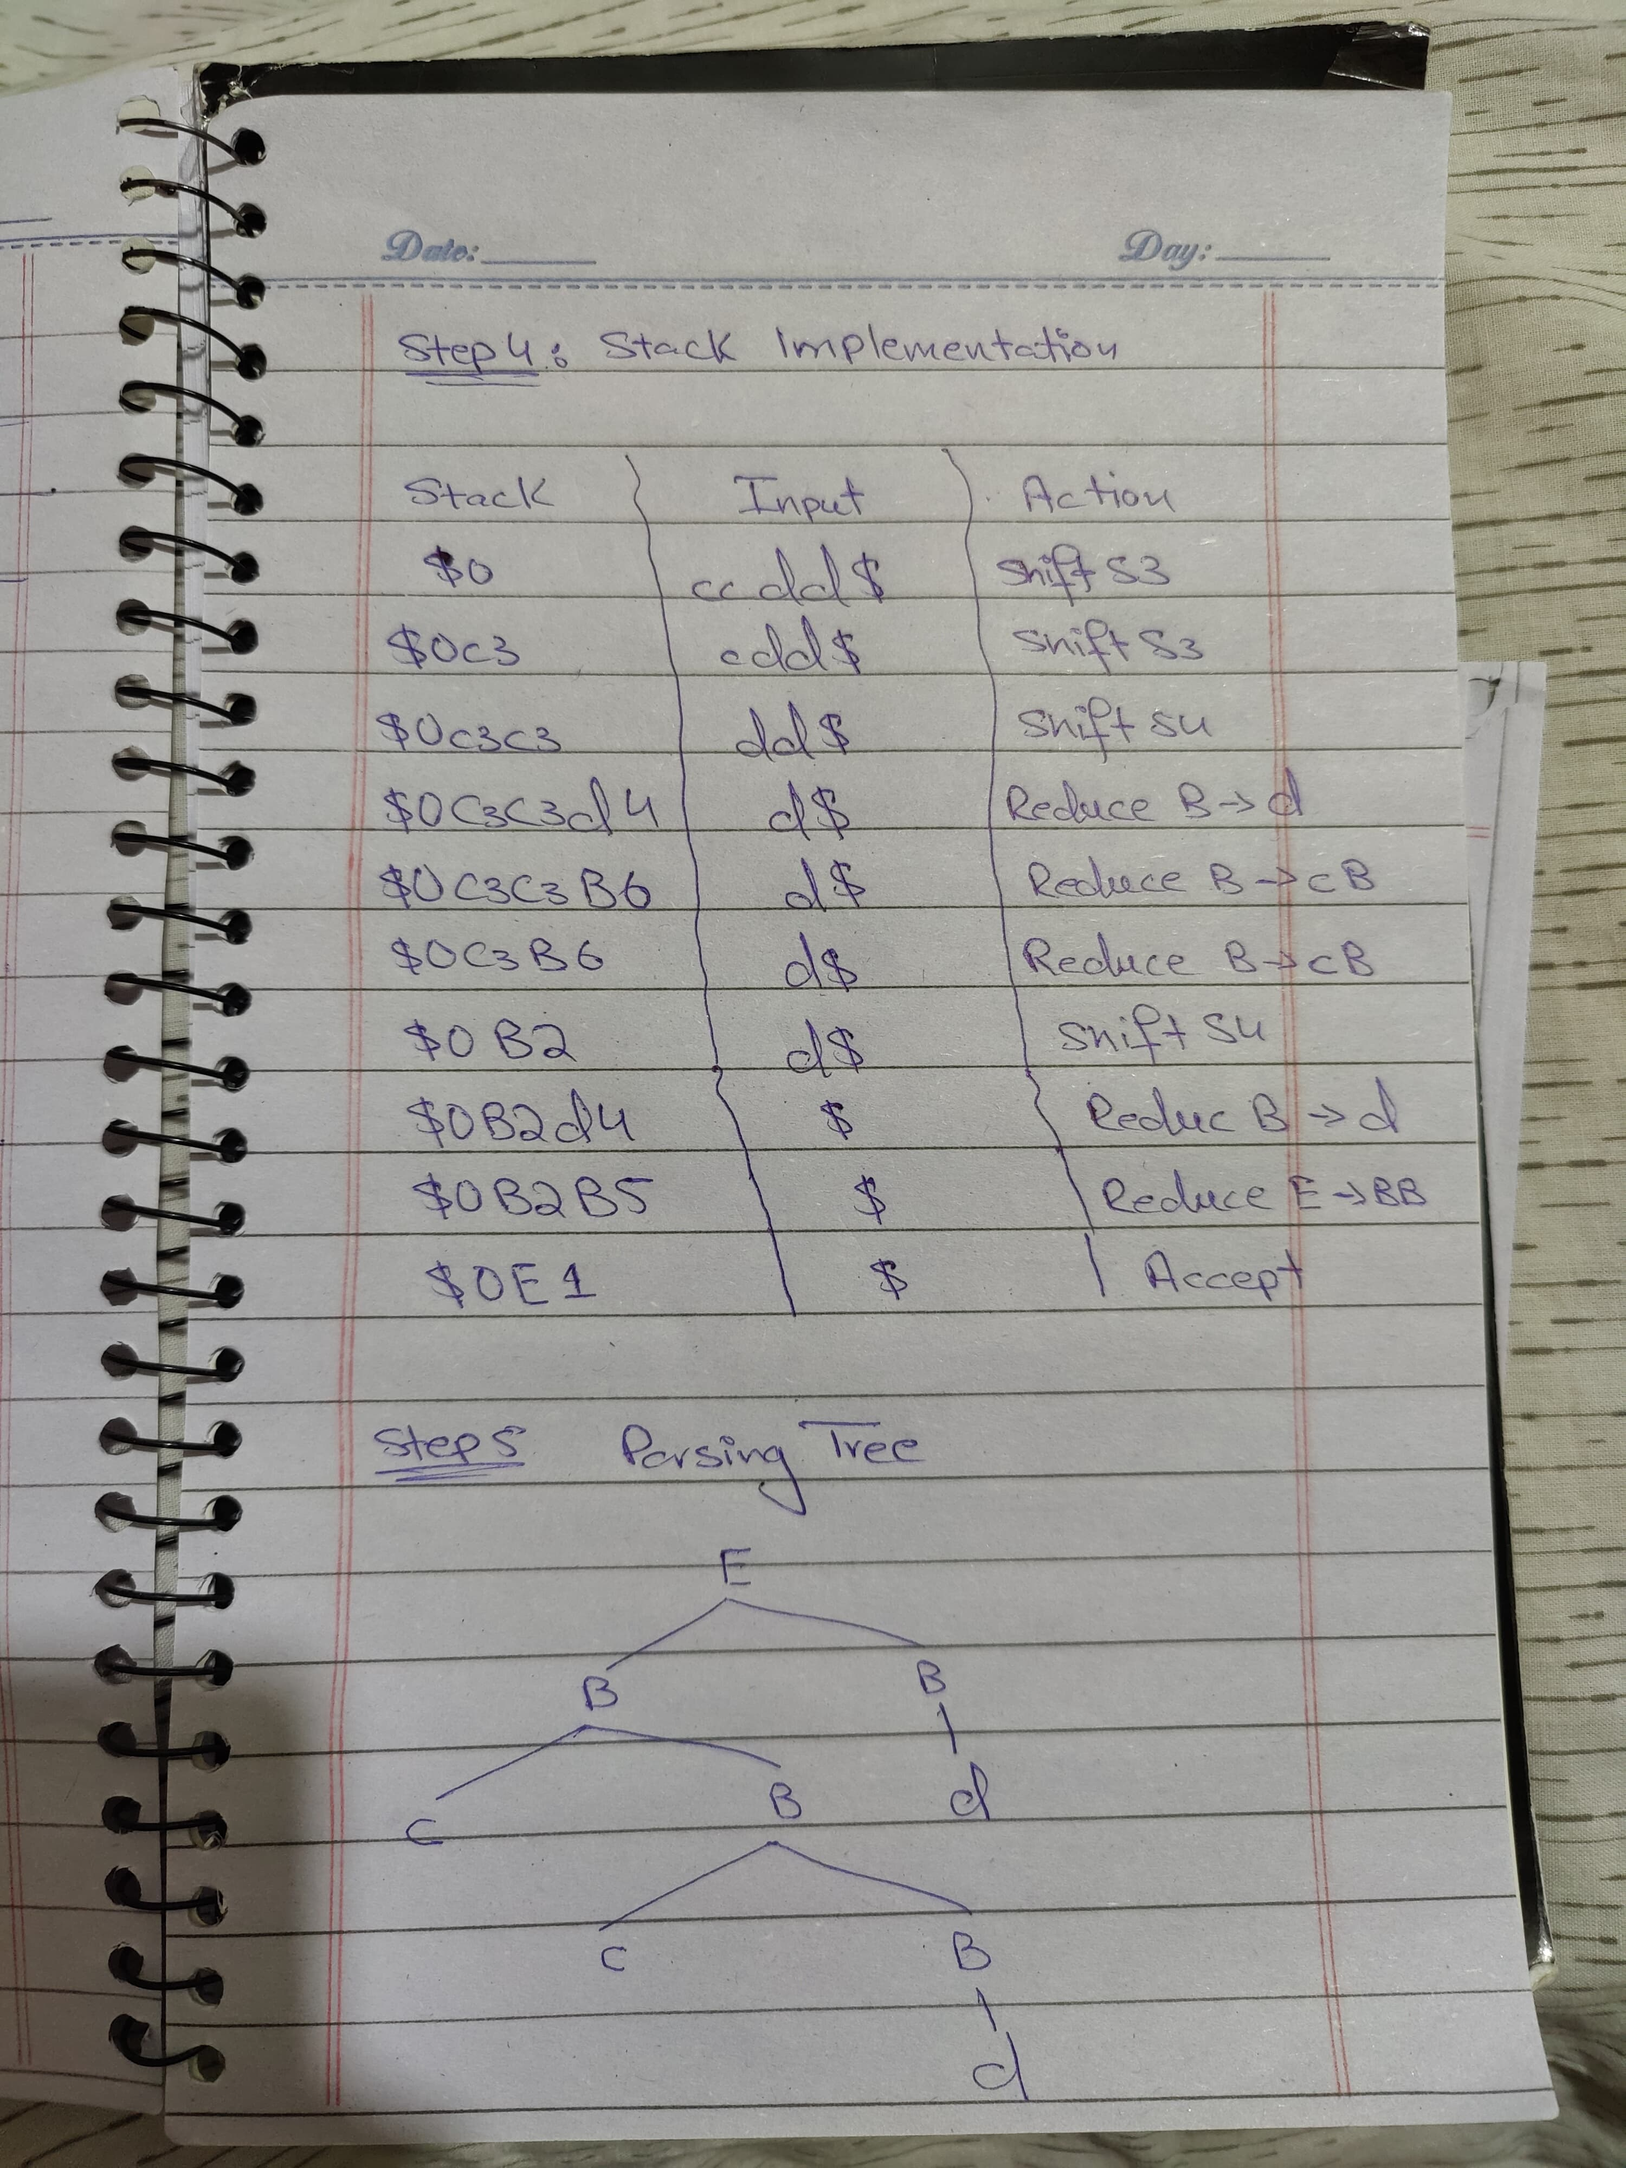
Example Question

Slide 12
Example Question

Slide 13
Thank you!
Any Question related to the topic?

